Slide 1
Machine Learning on the Electroencephalogram (EEG)
Kipp Johnson

Slide 2
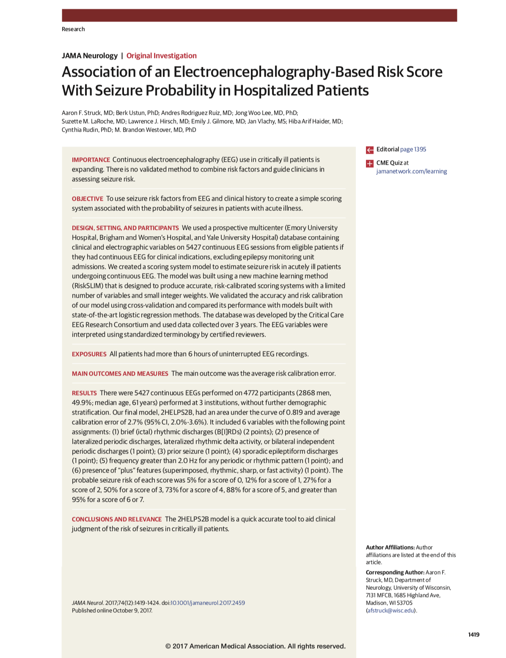
Association of an electroencephalography-based risk score with seizure probability in hospitalized patients
Struck et al. JAMA Neurology 2017
Notes:
Ask if anyone knows any of these authors personally

Slide 3
Goal of this paper
Our goal was to create a risk score similar to CHADS2 (congestive heart failure, hypertension, age greater than 75, diabetic, and history of stroke x2) …. that is, a simple additive model with a limited number of factors and small integer weights for quick calculations.

Slide 4
Dataset
5,427 EEGs measurements containing seizure observations in 4772 patients pooled from three sites
Seizure episodes were defined according to Young Criteria (Neurology 1996)
Seizures either:
(1) electrographic, or (2) electroclinical
Notes:
Data was hand-entered
In 2020, NEVER do this

Slide 7
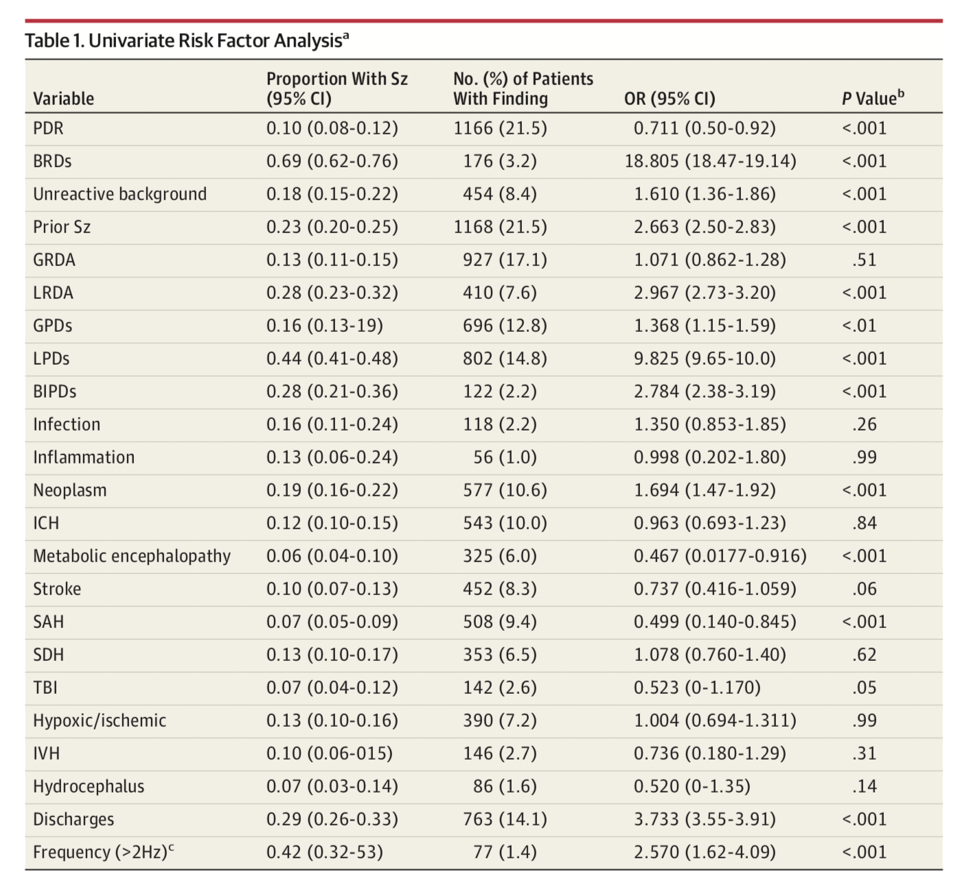
24 Candidate Variables
(Don’t ever do univariate screening to select model variables)
24 Categorical Variables
Notes:
Dichotomization of variables is bad. Don’t do it!
Do not ever do a univariate screening test
Even frequency what dichotomized. JFC
Variables were combined into single factors to simplify the prediction model and increase the effect size for each factor. This was performed for variables that are associated with a similar risk of seizures and rarely co-occur. To create a fre- quency binary variable, frequency was divided into binary vari- ables at each 0.5-Hz interval from 0.5 to 3 Hz. Each potential dividing point was analyzed to find the cut point with maxi- mal predictive value.

Slide 8
The first rule of machine learning:
Do not throw out information
Notes:
Taking this beautiful waveform and REMOVING information

Slide 9
What they started with
What they ended with
Notes:
Already I can tell that I am not going to like this paper

Slide 10
What is the goal of supervised learning?
f
X
Y
f
Finding an that applied to X predicts Y

Slide 11
What can be?
Linear regression
Logistic regression
Regularized regression
Support vector machines
Random forests
XGBoost (extreme gradient boosting)
DEEP LEARNING (neural networks)
Convolutional neural networks
Identity function
Etc
Etc
Ad infinitum
f

Slide 12
Risk-Calibrated Supersparse Linear Integer Model (RiskSLIM)
Looking for an equation or algorithm in the paper or supplementary material?
You won’t find it
“uses optimization techniques to find the best logistic regression model with bounded integer coefficients (integers between –10 and 10), and a limited number of risk factors (at most 6)”

Slide 13
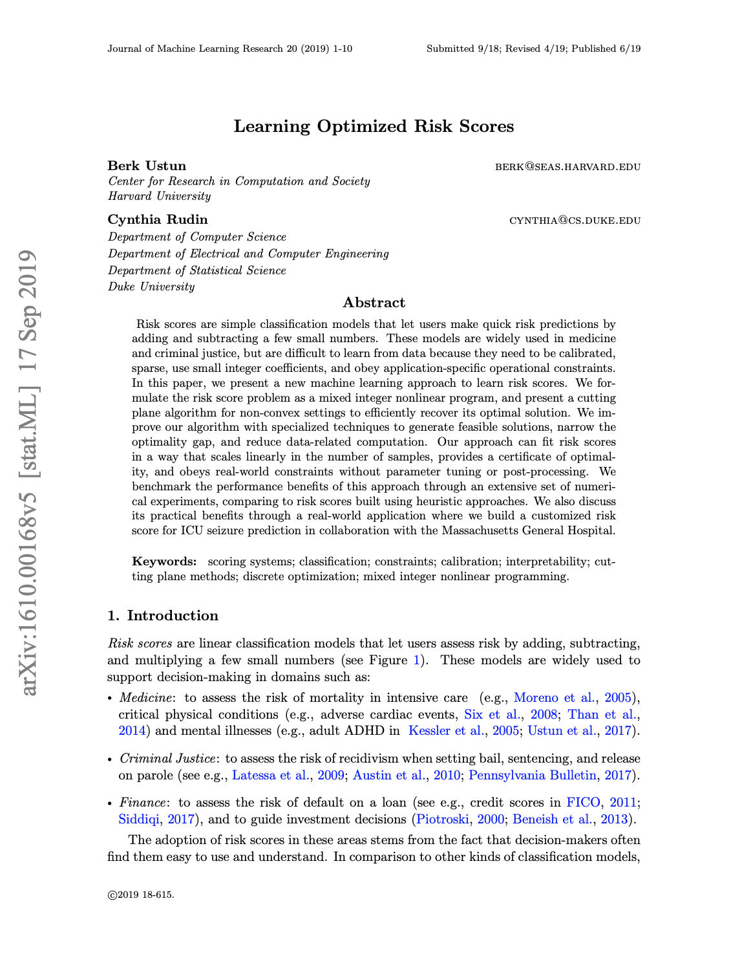
arΧiv 2019
Notes:
Actually very nice paper

Slide 14
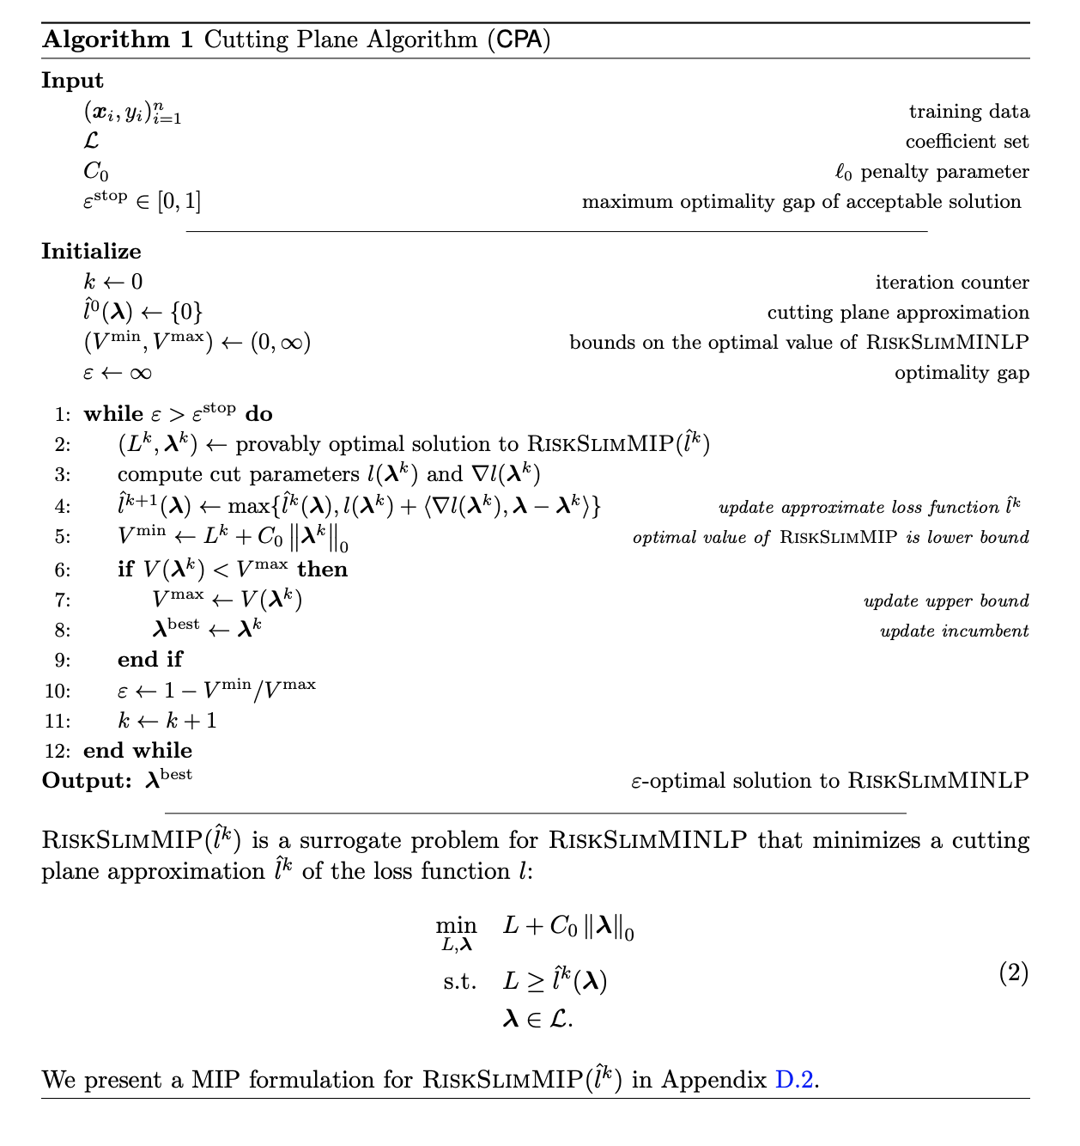
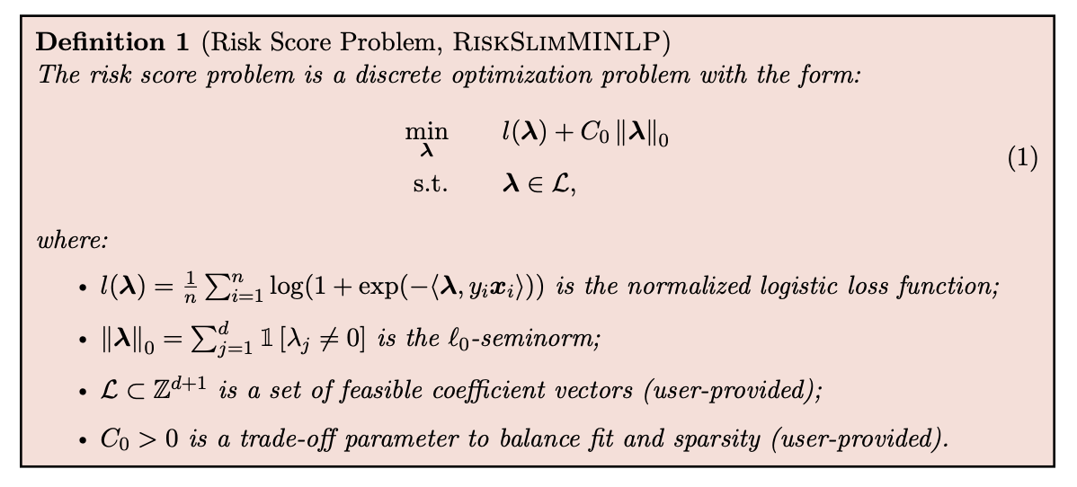

Slide 15
In one sentence: Logistic regression where coefficients are selected by integer programming

Slide 16
What are we predicting, exactly?
Not predicting anything actually – detecting
12.5% of EEGs had seizures
Y = did a seizure happen during this EEG?
Assessed with 5-fold CV, prediction calibration, AUROC
Fit all ~1200 possible models and take the best one

Slide 17
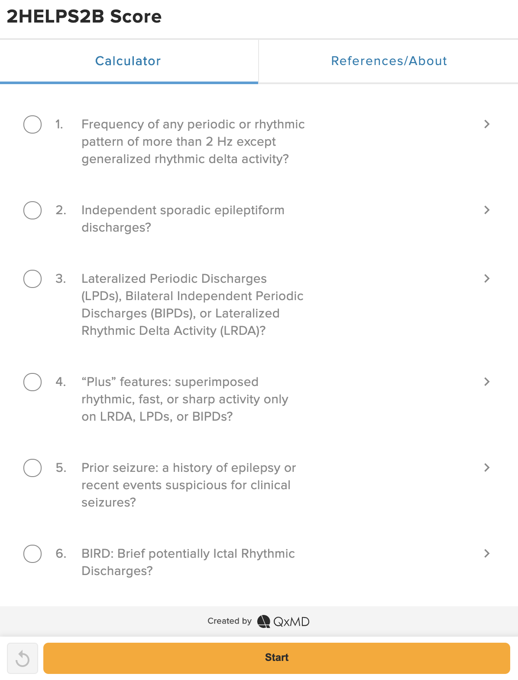
What’s the actual calculation a clinician could do?

Slide 18
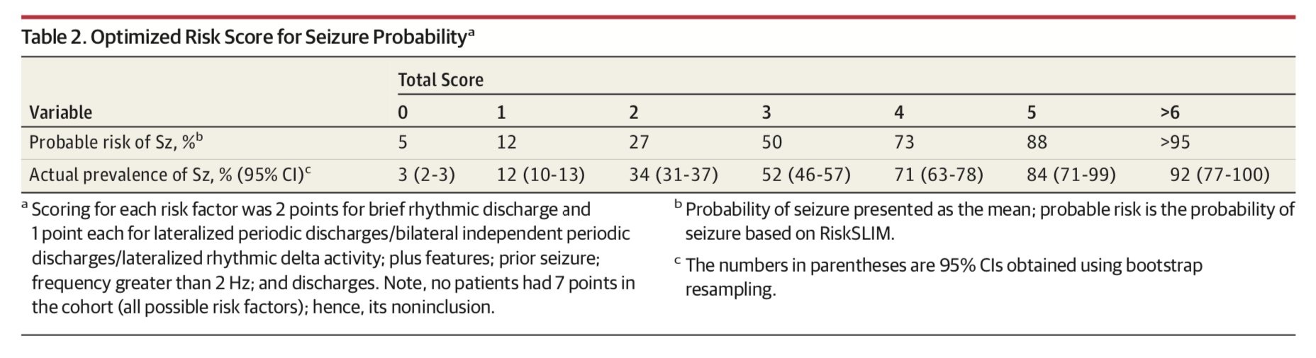
Seizure Probability by score

Slide 19
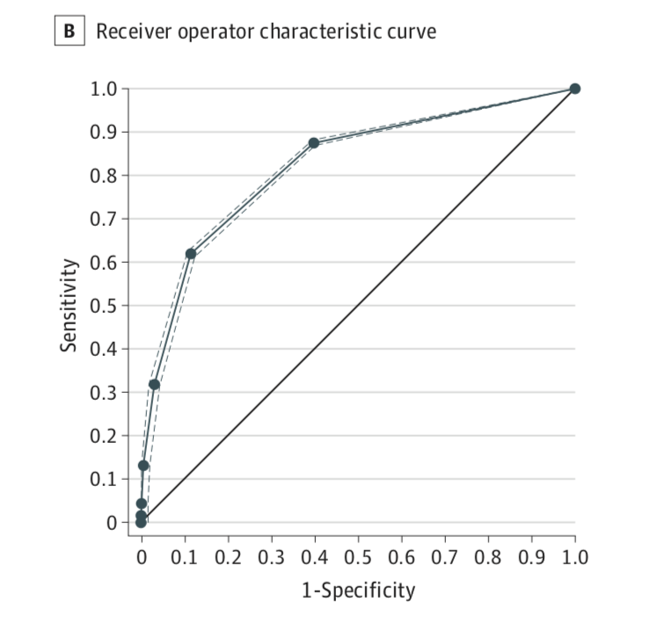
AUROC
0.82

Slide 20
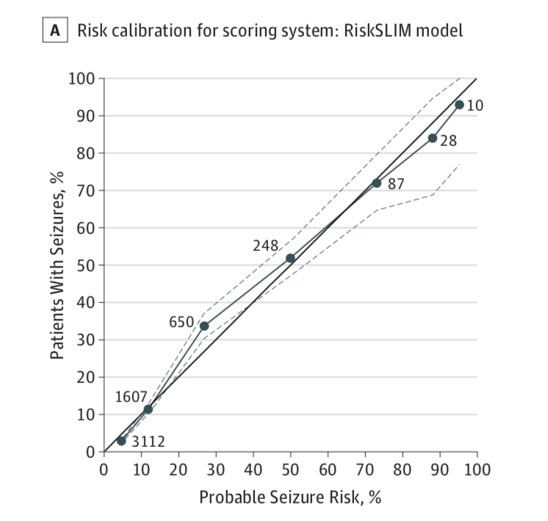
Calibration
(better way to assess model performance)
pretty good

Slide 21
Final Thoughts
5 EEG derived factors + 1 clinical factor may predict within a given EEG if there is likely to be a seizure or not (confusing test-train split)
Don’t throw out information – computer vision-based approaches likely far superior in accuracy at cost of easy computation
Question to group: Is this score used in practice?
Past life: We found that clinicians hate unnecessary information that complicates treatment with dubious benefit
Machine learning should make the clinician’s life easier, not more complicated

Slide 22
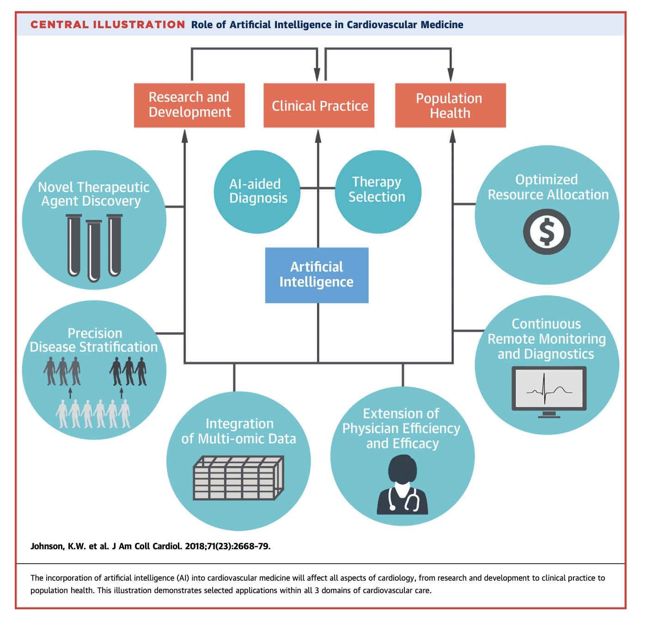
Neurological
Another score to remember?
👎
Computers doing it for you, giving you more time to focus on stuff that is interesting to you?
🤙🏼

